Slide 1
Recommend products to customers of online grocer based on their similarity to other customers (Capstone 2)
Sanjiv Shrestha

Slide 2
Context
Online grocers (e.g. Instacart)
Online grocers provide a software platform (both on mobile and desktops) that customers can use to browse various products/grocery items offered by different grocery stores that the online grocer has partnered with.
Once the customer submits the order via the software platform, online grocers take care of that order via shoppers and drivers that they have employed or contracted with. For the service they provide, they take a fee from their customers and their partner grocery stores.
Because of online grocers:
Busy customers don’t have to spend time/energy doing groceries
Partner grocery stores get an extra channel through which they get customers

Slide 3
Context (continued)
Online grocers
Strong interest in recommending relevant products to their clients
Client’s perspective:
Relevance of products typically implies better experience with online grocer’s brand and hence positive feelings for the brand
Online grocer’s perspective:
Relevance of products translates to longer-term stickiness of clients as well as potential upside in revenue from clients

Slide 4
Specific problem/opportunity
Online grocers can recommend products to their clients based on 2 primary ways:
Client’s product preferences based on their past product purchase history
Similarity of the client to other clients based on their behavioral, demographic or psychographic similarities
This project addresses online grocer like Instacart’s interest in recommending products to their clients based on behavioral similarity between clients

Slide 5
Methodology used for the project
Data collection
Data cleaning/wrangling
Data processing
Data exploration
Feature selection and Clustering
Recommendation of relevant products for each user

Slide 6
Data collection
Data obtained from Kaggle. Six files/dataframes were provided. The relevant five files/dataframes used for the project as follows:
df_orders df_order_products_prior df_products df_aisles
order_id
user_id
eval_set
order_number
order_dow
order_hour_of_day
days_since_prior_order
order_id
product_id
add_to_cart_order
reordered
product_id
product_name
aisle_id
department_id
aisle_id
aisle
df_departments
department_id
department

Slide 7
Data collection (continued)
Summarizing the data contained in the dataframes:
About 3.4M orders
About 200K users
About 50K products
134 aisles
21 departments

Slide 8
Data cleaning/wrangling
Treatment of null/NaN values
Dataframe df_orders had about 200K NaN values for one of its columns out of a total of about 3.4M rows
Rows corresponding to NaN values dropped since they accounted for < 10% of total number of rows
Treatment of outliers or bad/incorrect data points
All the columns of the five dataframes were reasonable in terms of min and max values. There were no outliers or bad/incorrect data points to be treated

Slide 9
Data processing
Five dataframes were combined into one single dataframe, to be explored for data insights
Memory issues when combining dataframes on laptop, hence used Google colab

Slide 10
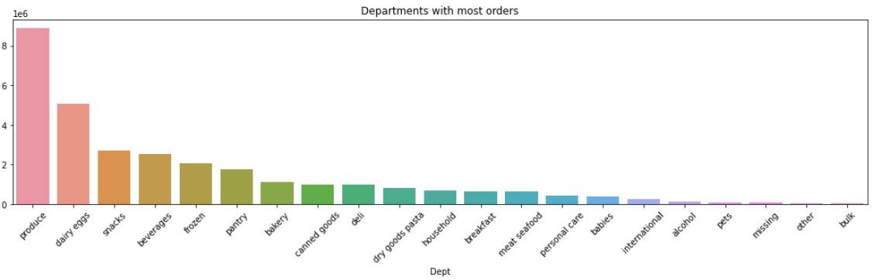
Data exploration
Produce, Dairy eggs and Snack top 3 departments (in terms of demand)

Slide 11
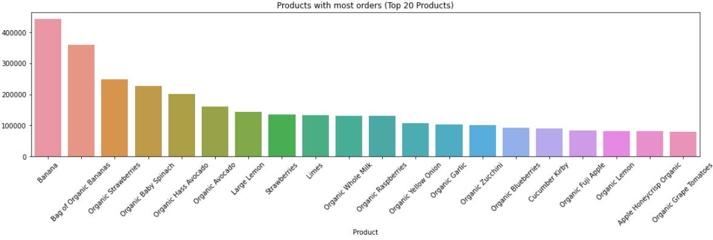
Data exploration (continued)
Bananas, Bag of organic bananas and Organic strawberries top 3 products ( in terms of demand)

Slide 12
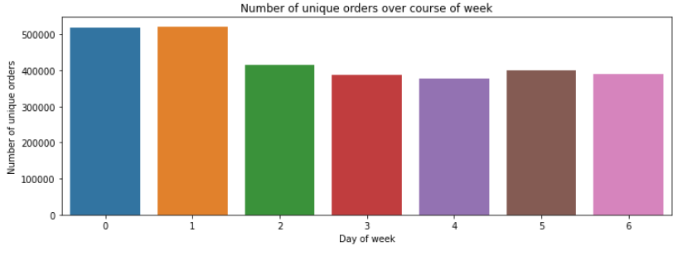
Data exploration (continued)
Days 0 and 1 (Saturday and Sunday) get more orders than days 2,3,4,5 and 6

Slide 13
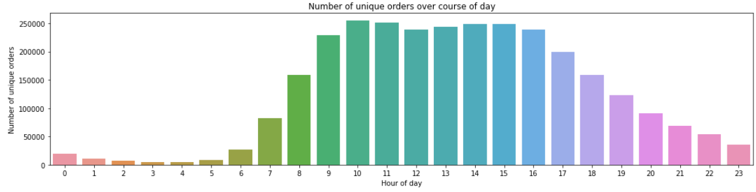
Data exploration (continued)
Orders start to pick up around 6am, hit the peak around 10am, stay at the peak till about 4pm after which they start to go down

Slide 14
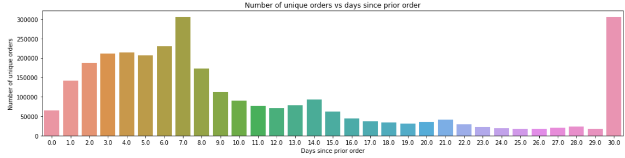
Data exploration (continued)
Peaks at days 7 and 30 indicate that there is a large segment of customers that order every week and another large segment of customers that order every month

Slide 15
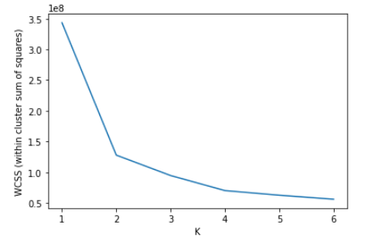
Feature selection and Clustering
3 features (which represent the behavioral attributes of the users )were selected to cluster the orders
order_dow : day of week of order
order_hour_of_day : hour of day of order
days_since_prior_order : days since prior/last order
Clustering was done using K-Means algorithm
Elbow point of 4 was used to cluster the orders into 4
different clusters

Slide 16
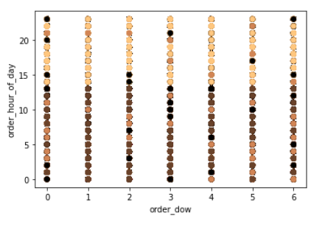
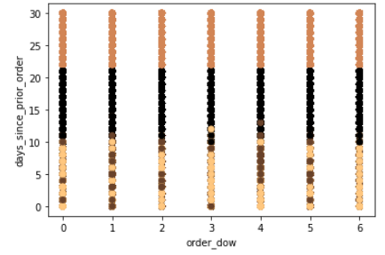
Feature selection and clustering (continued)
Cluster labels for order_hour_of_day vs order_dow and days_since_prior_order vs order_dow plots. Notice that 4 clusters are NOT clearly separated here

Slide 17
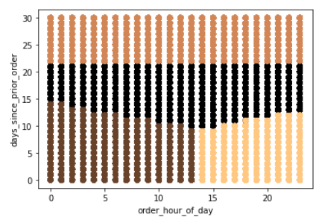
Feature selection and clustering (continued)
Cluster labels for days_since_prior_order vs order_hour_of_day plot. Notice that 4 clusters are clearly separated here indicating that these two features are the most useful ones for clustering orders

Slide 18
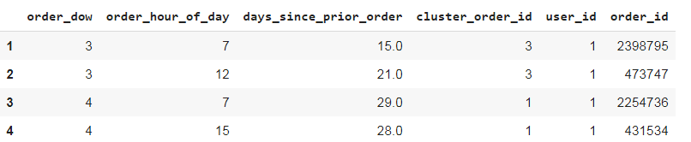
Feature selection and clustering (continued)
Each user has multiple orders and hence each user will end up having multiple cluster labels as is seen below
The dominant/most frequent cluster label is chosen for a user and is assigned as the “cluster label” for the user

Slide 19
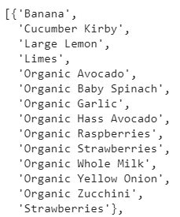
Product recommendations for each user
Top 15 products for each cluster are identified
For each user:
Top 15 products (for the dominant cluster that the user belongs to) are compared against the products purchased by the user in the past
Top 15 products that have not been purchased by the user in the past are recommended to the user
Products recommended to a sample user would look something as follows:

Slide 20
Further work
Use other techniques like DBSCAN and Spectral clustering to cluster users
Compute mean values of behavioral attributes (order_dow, order_hour_of_day and days_since_prior_order) for each user and use the mean values to cluster the users vs using the method of selecting the dominant/most frequent cluster label for the user as was done in this project
Use product preferences of users (as opposed to behavioral attributes of users as was done in this project) to cluster users

